Slide 1


SNOWFALL PREDICTION IN
UTTARAKHAND
GROUP NO. 3:
AKRITI DHYANI-TS90723
ANUSHA PARIDA-TS90729
MANISHA SHETTY-TS90728
VASUDHA GOPALAKRISHNA-TS90573

Slide 2

SNOWFALL PREDICTION IN
UTTARAKHAND

Slide 3

Problem Statement:
Climate change, a global concern, is evident in declining snowfall rates. Linked to rising temperatures, the depth of snow has globally decreased since the late 1950s. Despite punishing winter temperatures in Northern India, snowfall onset is delayed, with lower amounts this season. Climate variability, caused by a shift in global wind patterns, led to late snowfall onset in recent years.
This year, the Westerly jet stream shifted, causing delays in rain and snow. Uttarakhand faces a similar pattern with delayed snowfall and lower rainfall due to fewer western disturbances. Western disturbances, originating over the Mediterranean, play a vital role in India's winter weather. However, climate change affects their frequency and strength. La Nina, cooling ocean temperatures, contributes to a 3°C temperature increase in plains.
Contrary to expectations, recent studies show reduced snowfall over the western Himalaya due to a warming climate. Changes in wind direction from colder westerlies to warmer easterlies, influenced by western disturbances, lead to rain and reduced snowfall.

Slide 4
Extreme weather events associated with global warming, like La Nina and El Nino, contribute to erratic weather patterns and reduced snowfall. The impact on the northwest's ecology, water resources, and Agro-forestry is significant.
Studies reveal decreasing winter precipitation and snowfall trends, affecting river flow and agriculture. A DRDO study notes increased temperatures below 4,000 m but a decreasing trend above this altitude. Lower altitudes experience significant snowfall decreases, impacting water availability, river flow, and Agro-forestry. Diminished snow cover, reduced glacier accumulation, and accelerated melting due to climate change pose unprecedented risks to the region.
OBJECTIVE: Through this project we Aim to study snowfall patterns throughout the years as well as predict the snowfall rate for coming years.
DATASET SOURCE
We used dataset from ERA5 which has resolution of 9km.
Time period : 2015 to 2021
Reference paper used: A comparative Analysis of ML Algorithms for Snowfall Prediction.

Slide 5
Data Collection
MODEL ARCHITECTURE
Temperature
Pressure
Latitude
Model Performance(R²,RMSE,MAE)
Wind velocity at different heights
Geographical Variable
Longitude
Climate Variables
Snowfall Parameters
Orography
Model Comparison
Cloud cover parameters
Surface stress at different levels
MLR
f_{MLR}(X)
LR
Data Pre-processing
fLR(X)
RFR
Input Variables
f_{RF}(X)
RR
Prediction Model Training
fRR(X)
MLR
LR
Machine Learning
Output Variables
Optimal Model
RFR
RR

Slide 6

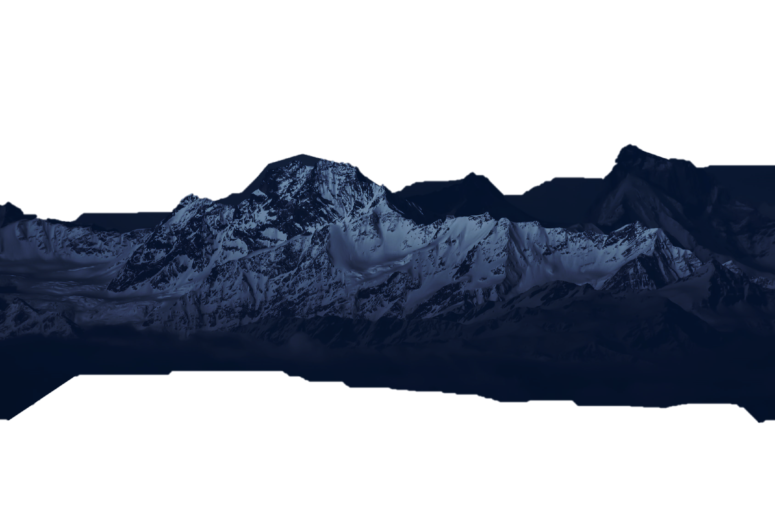
PREPROCESSING:
3. Converting NetCDF to CSV: The netcdf2csv library is employed to convert the loaded NetCDF data into a CSV format. This step facilitates easier handling and analysis of the data.
1. Importing Necessary Libraries: The code begins by installing and importing essential libraries, including xarray, netCDF4, google. colab, and pandas.
2. Loading NetCDF Data: The NetCDF data is loaded from the specified file path using the netCDF4 library.
4. Reading CSV Data into a Data Frame: The converted CSV data is read into a Pandas Data Frame for further manipulation and analysis.

Slide 7
PREPROCESSING:
1. Importing Necessary Libraries: The code begins by installing and importing essential libraries, including xarray, netCDF4, google. colab, and pandas.
3. Converting NetCDF to CSV: The netcdf2csv library is employed to convert the loaded NetCDF data into a CSV format. This step facilitates easier handling and analysis of the data.
2. Loading NetCDF Data: The NetCDF data is loaded from the specified file path using the netCDF4 library.
4. Reading CSV Data into a Data Frame: The converted CSV data is read into a Pandas Data Frame for further manipulation and analysis.

Slide 8

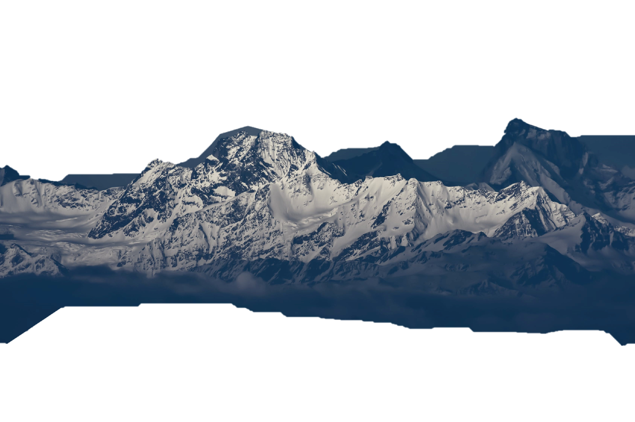
Variance Inflation Factor (VIF) Calculation: The code calculates the VIF for selected features, aiding in identifying multicollinearity. The features with high VIF values are systematically removed to enhance model robustness.
Column Renaming: The columns in the Data Frame are renamed for better readability and understanding of the data, specifically related to weather variables.
Data Cleaning and Exploration: The Data Frame is cleaned and explored, including checking for missing values. Additionally, the data types of the 'time' column are converted to datetime and time, and a correlation matrix heatmap is generated to identify potential relationships among variables.
Feature Selection: Features are iteratively removed based on their VIF values, leading to a refined set of features with reduced multicollinearity.

Slide 9
Variance Inflation Factor (VIF) Calculation: The code calculates the VIF for selected features, aiding in identifying multicollinearity. The features with high VIF values are systematically removed to enhance model robustness.
Column Renaming: The columns in the Data Frame are renamed for better readability and understanding of the data, specifically related to weather variables.
Feature Selection: Features are iteratively removed based on their VIF values, leading to a refined set of features with reduced multicollinearity.
Data Cleaning and Exploration: The Data Frame is cleaned and explored, including checking for missing values. Additionally, the data types of the 'time' column are converted to datetime and time, and a correlation matrix heatmap is generated to identify potential relationships among variables.

Slide 10
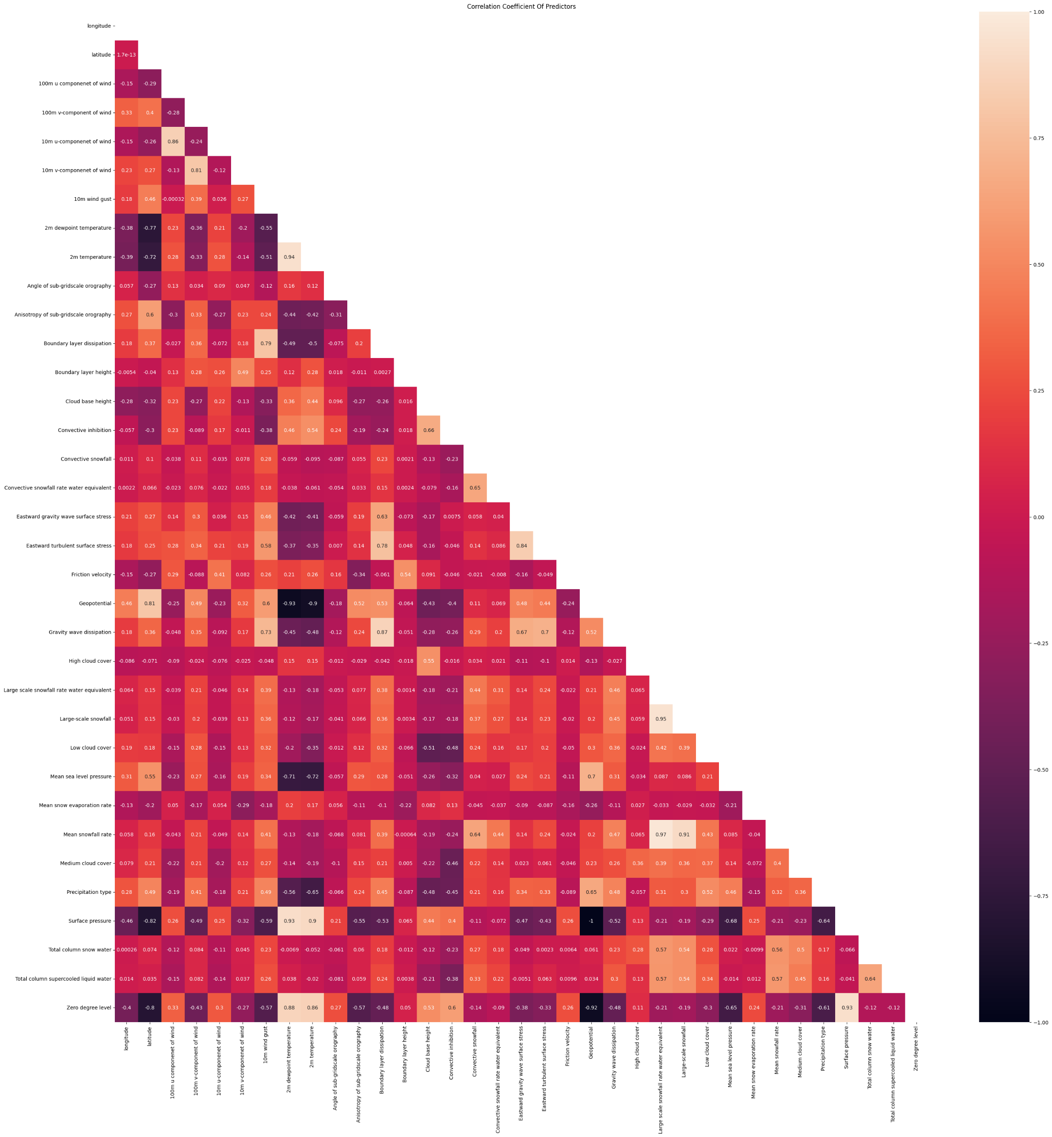
HEATMAP:

Slide 11
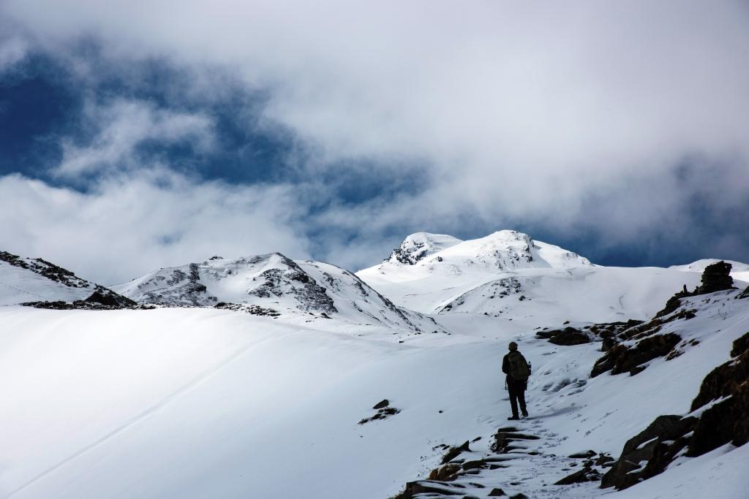
Linear regression predicts the relationship between two variables by assuming a linear connection between the independent and dependent variables. It seeks the optimal line that minimizes the sum of squared differences between predicted and actual values.
Logistic regression is the appropriate regression analysis to conduct when the dependent variable is dichotomous (binary). Like all regression analyses, logistic regression is a predictive analysis. It is used to describe data and to explain the relationship between one dependent binary variable and one or more nominal, ordinal, interval or ratio-level independent variables.
Ridge regression—also known as L2 regularization—is one of several types of regularization for linear regression models. Regularization is a statistical method to reduce errors caused by overfitting on training data. Ridge regression specifically corrects for multicollinearity in regression analysis.
This estimator builds an additive model in a forward stage-wise fashion; it allows for the optimization of arbitrary differentiable loss functions. In each stage a regression tree is fit on the negative gradient of the given loss function.
Random Forest Regression is a versatile machine-learning technique for predicting numerical values. It combines the predictions of multiple decision trees to reduce overfitting and improve accuracy.
RandomForestRegressor – This is the regression model that is based upon the Random Forest model or the ensemble learning that we will be using in this project using the scikitlearn library.
LINEAR REGRESSION
LOGISTIC REGRESSION
RANDOM FOREST REGRESSION
RIDGE REGRESSION
GRADIENT-BOOST REGRESSION

Slide 12
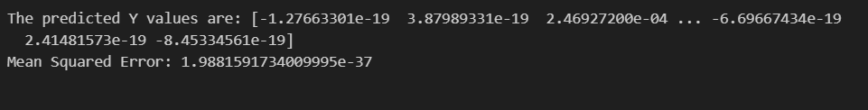
Linear Regression
Procedure:
It imports necessary libraries such as Pandas for data manipulation and scikit-learn for modeling and evaluation. Meteorological features, including wind components, temperature, and others, are selected as input, while snowfall is the target variable. Data preprocessing involves handling missing values and normalizing using Min-Max scaling. The dataset is split into training and testing sets, and a linear regression model is trained on the training data. The code aims to forecast snowfall based on given meteorological conditions.
Evaluation metrics used:
Mean squared Error: Predictions are made on the test set, and model performance is evaluated using Mean Squared Error. In statistics, the mean squared error or mean squared deviation of an estimator measures the average of the squares of the errors—that is, the average squared difference between the estimated values and the actual value.

Slide 13
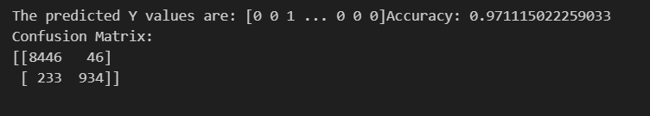
Logistic Regression
Procedure:
The code employs logistic regression for binary snowfall prediction based on meteorological features. It imports Pandas for data manipulation and scikit-learn for modeling and evaluation. Relevant features are selected, and a binary target variable is created (1 if snowfall exceeds a threshold, 0 otherwise). Data preprocessing involves handling missing values and normalizing using Min-Max scaling. The dataset is split into training and testing sets, and a logistic regression model is trained on the scaled training data.
Evaluation Metrics used:
Predictions are made on the test set, and model performance is evaluated using accuracy and a confusion matrix. A confusion matrix assesses model performance by tabulating true positives, true negatives, false positives, and false negatives in classification. True Positive (TP): 934 - This represents the number of instances where the model correctly predicted snowfall (actual snowfall occurred, and the model predicted snowfall).False Positive (FP): 46 - This is the number of instances where the model incorrectly predicted snowfall (actual no snowfall occurred, but the model predicted snowfall).True Negative (TN): 8446 - This indicates the number of instances where the model correctly predicted no snowfall (actual no snowfall occurred, and the model predicted no snowfall).False Negative (FN): 233 - This is the number of instances where the model incorrectly predicted no snowfall (actual snowfall occurred, but the model predicted no snowfall).

Slide 14
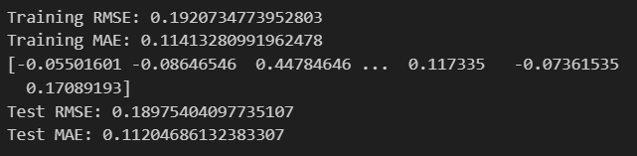
Ridge Regression
Procedure:
This code implements Ridge Regression using scikit-learn. It trains the model on the training set, predicts on both training and test sets, and evaluates performance using Root Mean Squared Error (RMSE) and Mean Absolute Error (MAE). The hyperparameter alpha is set to 1. The results provide insights into the model's accuracy on both training and test data.
Evaluation metrics used:
Training RMSE (Root Mean Squared Error): Measures the average deviation between predicted and actual values, providing a sense of the model's fit to the training data.
Training MAE (Mean Absolute Error): Evaluates the average absolute difference between predicted and actual values, giving insights into prediction accuracy.
Test RMSE (Root Mean Squared Error): Assesses the model's performance on unseen data, indicating how well predictions generalize to new observations.
Test MAE (Mean Absolute Error): Measures prediction accuracy on the test set, helping understand the model's effectiveness in real-world scenarios. These metrics offer a comprehensive evaluation of the Ridge Regression model's accuracy and generalization capabilities.

Slide 15
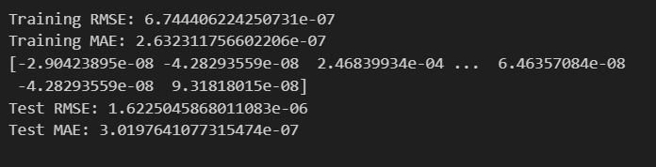
Gradient Booster Regression
Procedure:
This code employs a Gradient Boosting Regressor for snowfall prediction. Key steps include selecting features, splitting data into training and testing sets, and training the model. Predictions are made on the test set, and performance is evaluated using RMSE and MAE metrics.
Evaluation metrics used:
The training phase for a regression model yielded RMSE of 6.74 and MAE of 2.63. The model predicts snowfall accurately on the test set, with RMSE 1.62 and MAE 3.01.

Slide 16
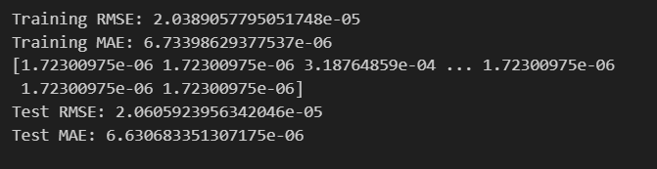
Random Forest Regression
Procedure:
This code employs a RandomForestRegressor to predict snowfall based on meteorological features. The model is trained on the training set, evaluated for accuracy using training RMSE and MAE. Predictions are then made on the test set, and the model's performance is assessed with test RMSE and MAE, indicating accurate snowfall predictions
Evaluation metrics used:
Assess model performance on training set (Training RMSE: 2.03, MAE: 6.73).Test Set Predictions: Utilize the trained model to make predictions on the test set. Test Set Evaluation: Evaluate model performance on the test set (Test RMSE: 2.06, MAE: 6.6).

Slide 17
THANK YOU!

